Slide 1
Hello Viewer Capstone Project By Jatin Bhardwaj
Topic – Covid Data Analysis

Slide 2
Problem Statement:
In Year 2020 when Corona Virus Knocked , that was the most terrifying time for whole World.
Many People Died , Many Lost their Loved ones.
In this Project I Have Analyzed Corona Virus :-
1. How Many People Survived , How many Failed to.
2. Male Survived the Pandemic easily or Women.
3. If any Other Disease had any Impact on the Dead ones.
4. How Imbalanced Dataset can cause Problems while Building the models, what are those problems , How to Solve.

Slide 3
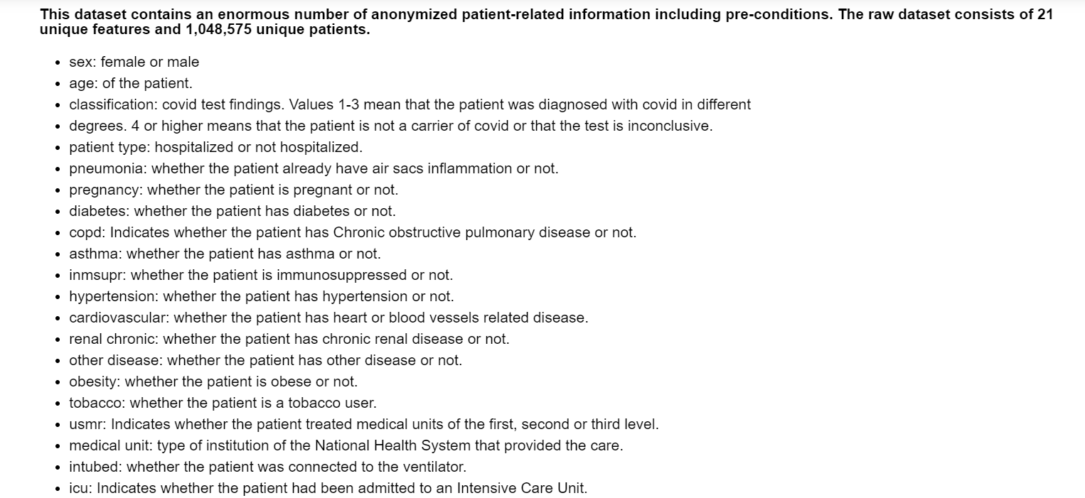
Some Information Of Dataset.

Slide 4
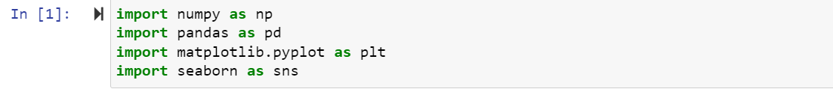
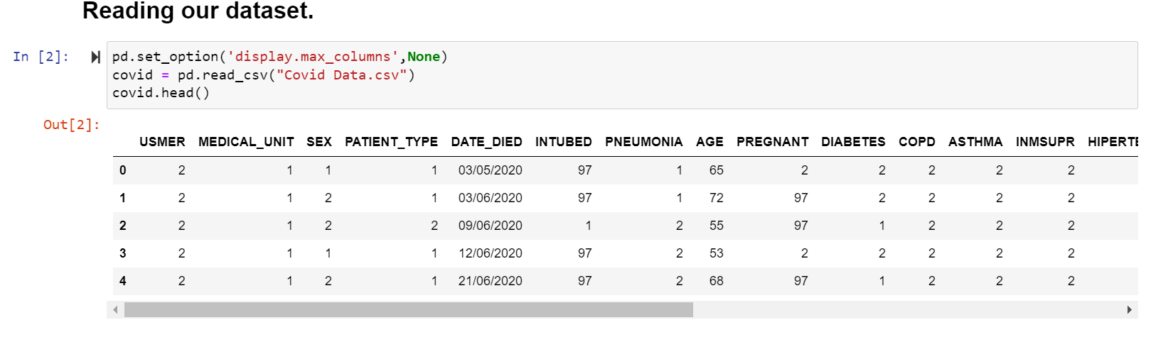
Importing of the modules. Reading and a Look at the Data.

Slide 5
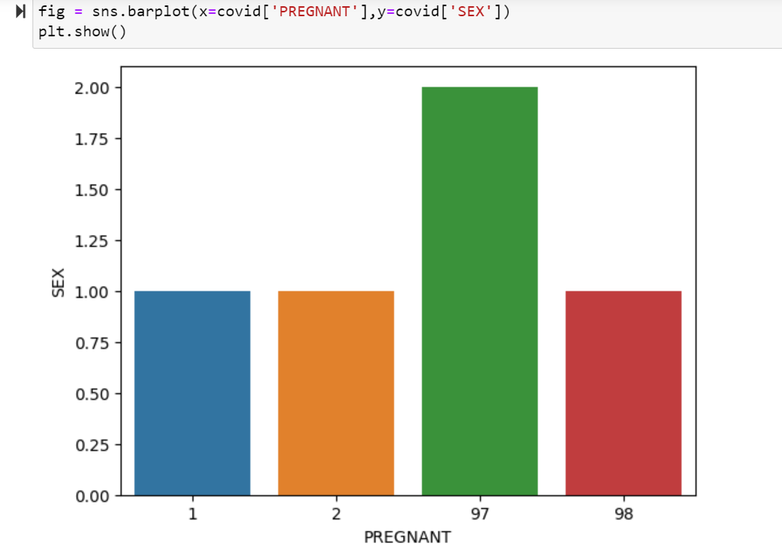
Some columns were kinda misleading, so I dealt with those columns.

Slide 6
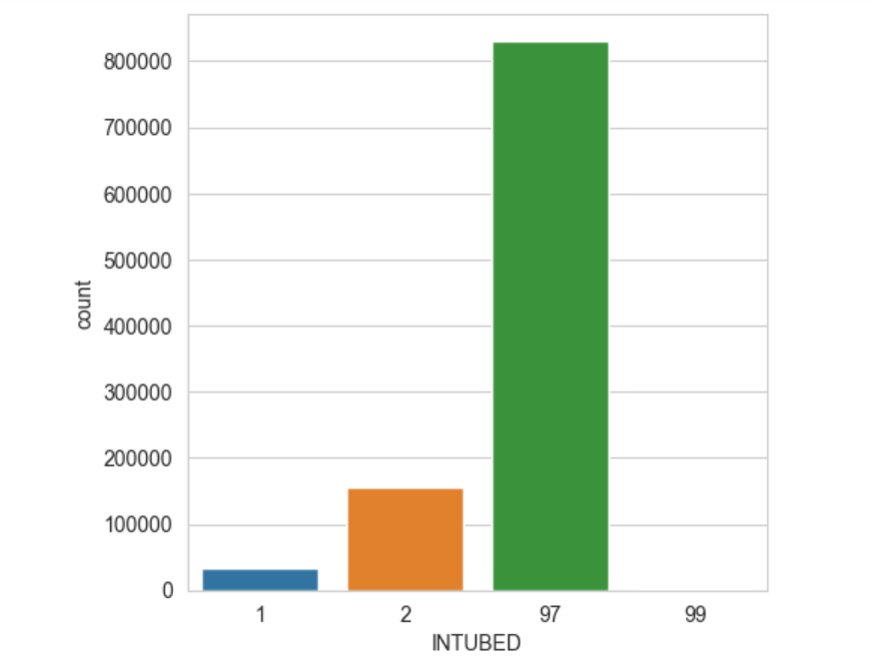
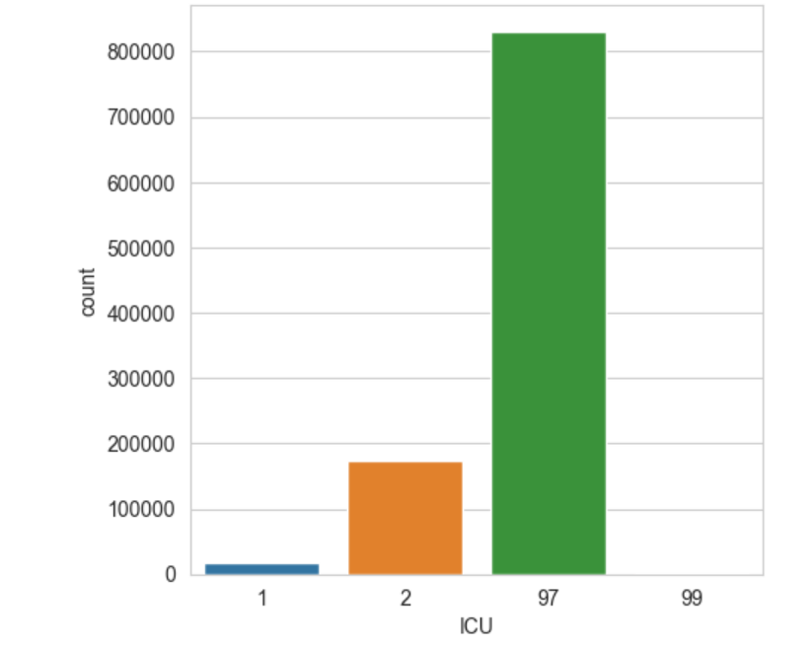
Dropped Columns having huge Missing Data.

Slide 7
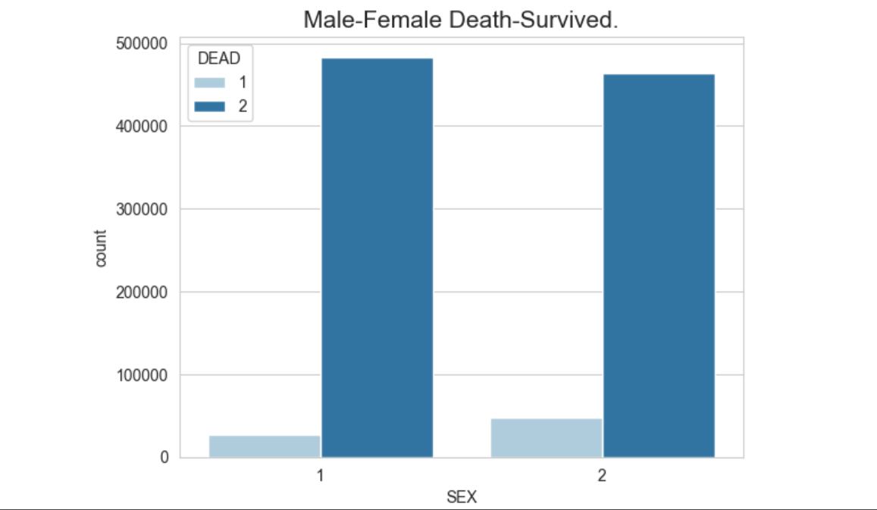
Survival Rate.

Slide 8
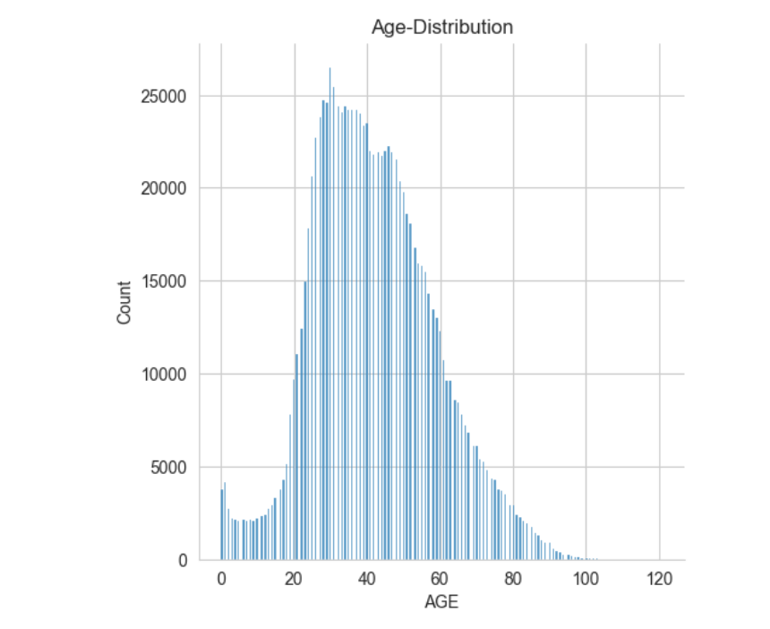
Distribution Of Age

Slide 9
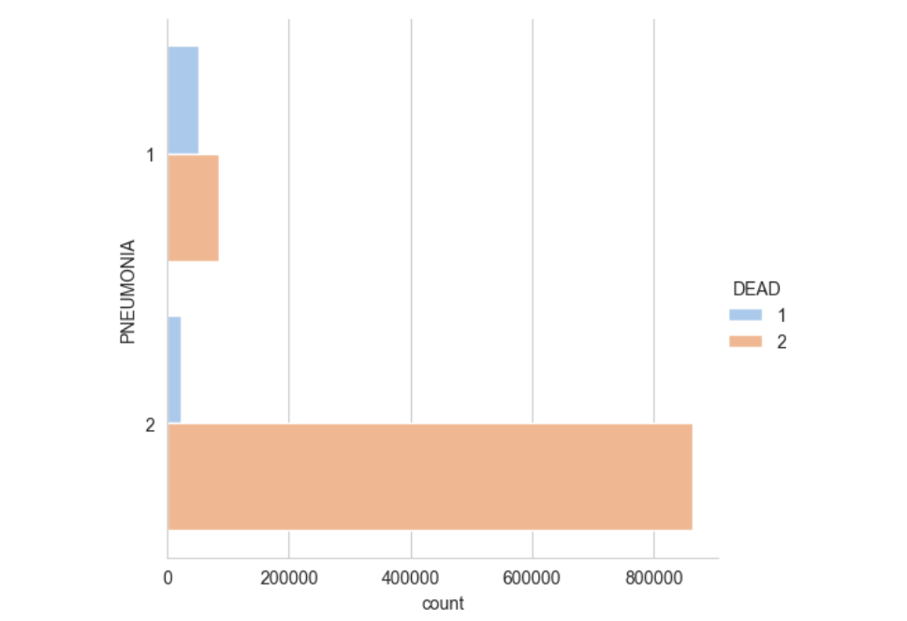
Was Pneumonia a Death Cause?

Slide 10
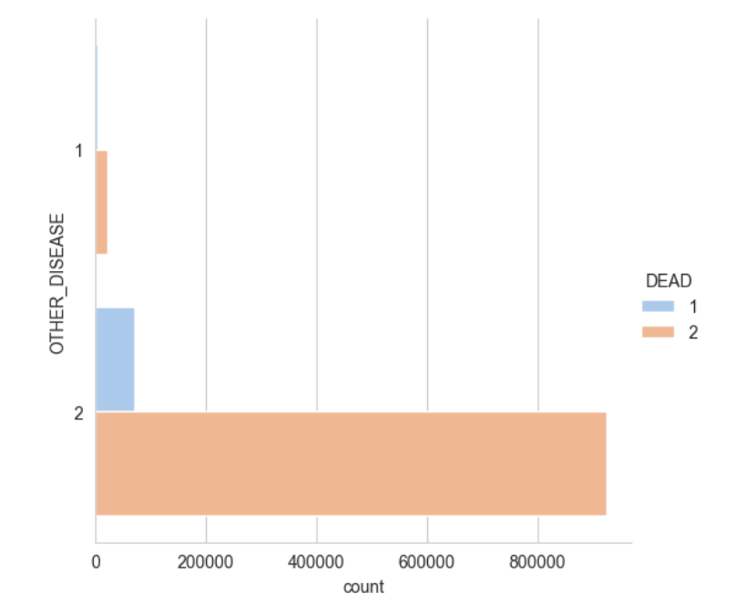
Other Disease had any imapact?

Slide 11
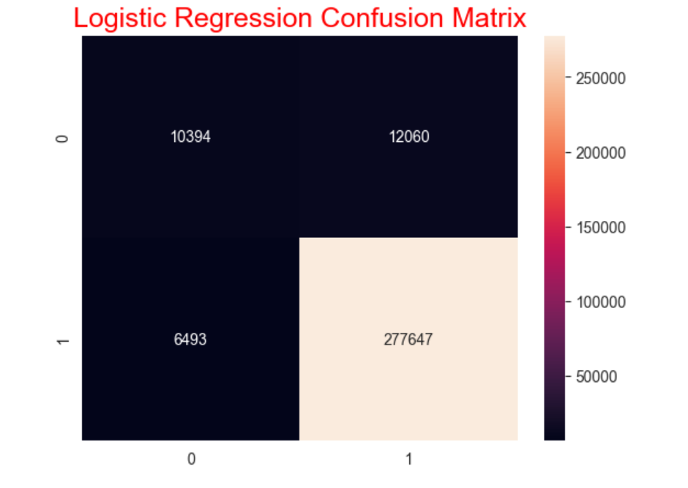
Build Logistic Regression Model and checked Confusion Matrix.

Slide 12
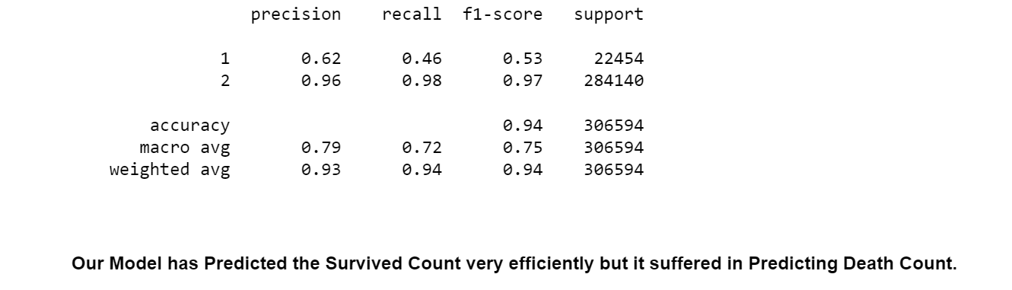

Slide 13
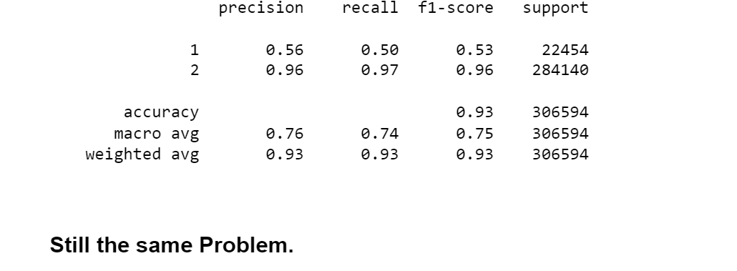
With Decision Tree

Slide 14
Why was this Happening?
The Major reason for this was The Imbalanced Dataset.
Difference in the Count of Dead ones and the Survived Ones is very very huge.
Let’s Check
Can See the difference very clearly
1 is for those who can’t make it.
2 is for those who made it.

Slide 15
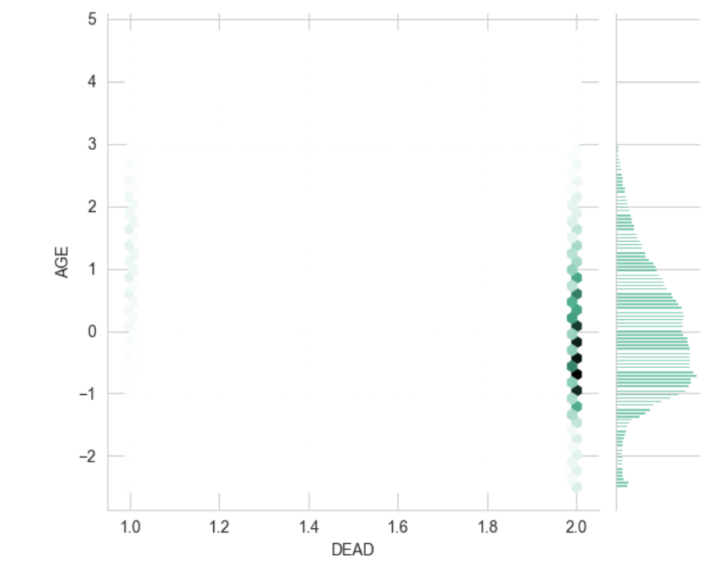
What is Under-Sampling and How it works ?
Under-sampling : Under-sampling is a technique to balance uneven datasets by keeping all of the data in the minority class and decreasing the size of the majority class.

Slide 16
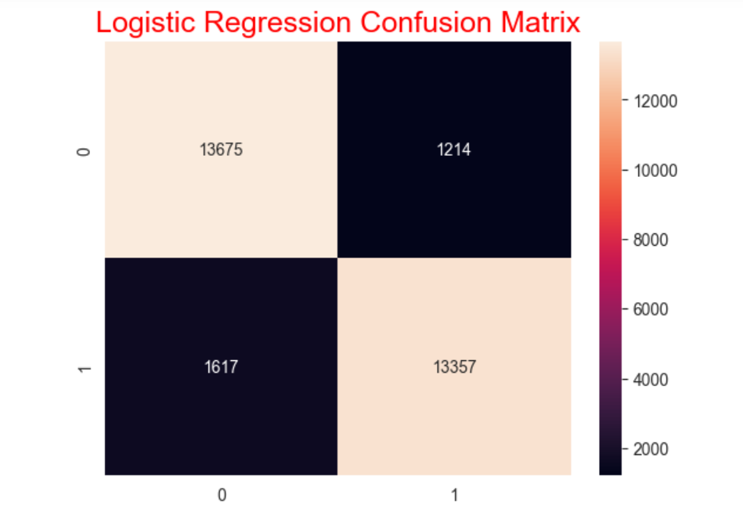
After Under-Sampling, Confusion Matrix

Slide 17
Why Under-Sampling and not Over-Sampling?
We could have gone for Over-Sampling but as our dataset contains more than 10lac of records it would have increased this count by a decent number.
That's why I used Under-Sampling Here.

Slide 18
Conclusion:-
Everything was going great:-
1. We checked Male-Female Survival Rate.
2. How Pneumonia played a major role.
And many more visualization
Then we saw our Dataset Is Highly Imbalanced,
Our model was predicting Survival Count very Easily but
was bad in Predicting the Dead one’s Count.
Then We did Under-Sampling and Checked Again.
And, it gave much better prediction as compared to the older one.

